Slide 1
In-Datacenter Performance Analysis of a Tensor Processing Unit
Google，ISCA2017
范志华
2019-03-28

Slide 2
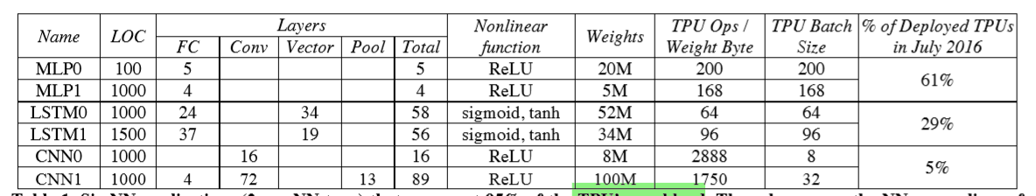
Motivation
Neural networks：
Multi-Layer Perceptrons (MLP)
Convolutional Neural Networks (CNN)
Recurrent Neural Networks (RNN)

Slide 3
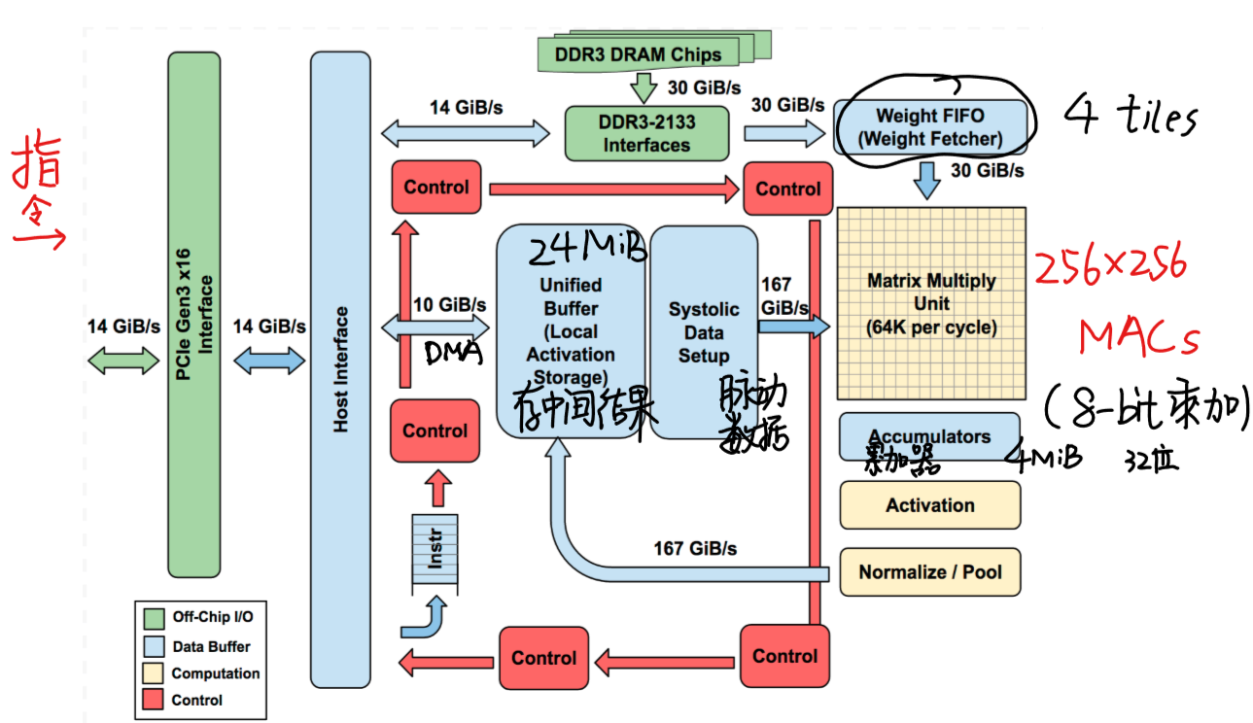
TPU
协处理器：PCIe
Host送指令
CISC（12）：
Read_Host_Memory
Read_Weights
MatrixMultiply/Convolve
Activate
Write_Host_Memory
四级流水线

Slide 4
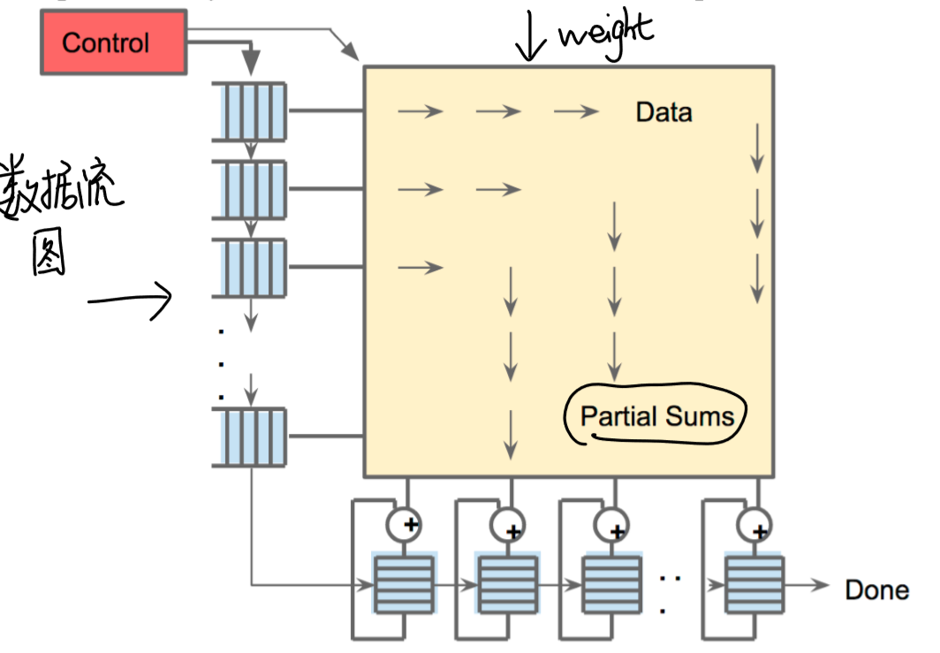
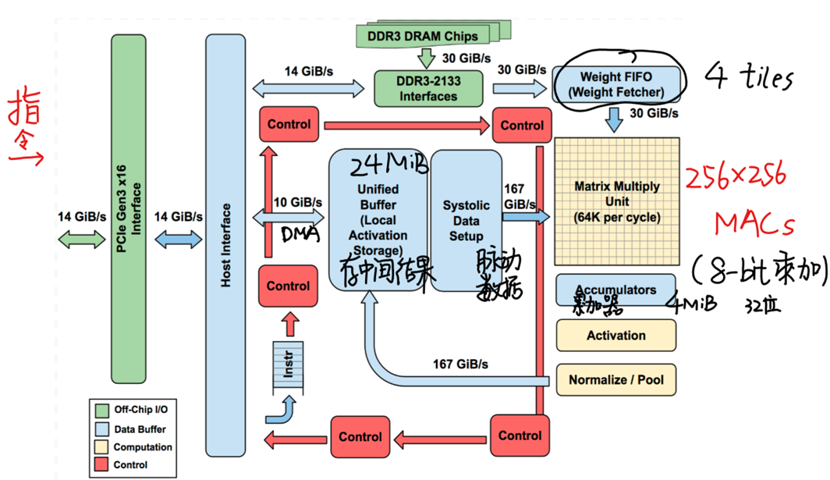
TPU

Slide 5
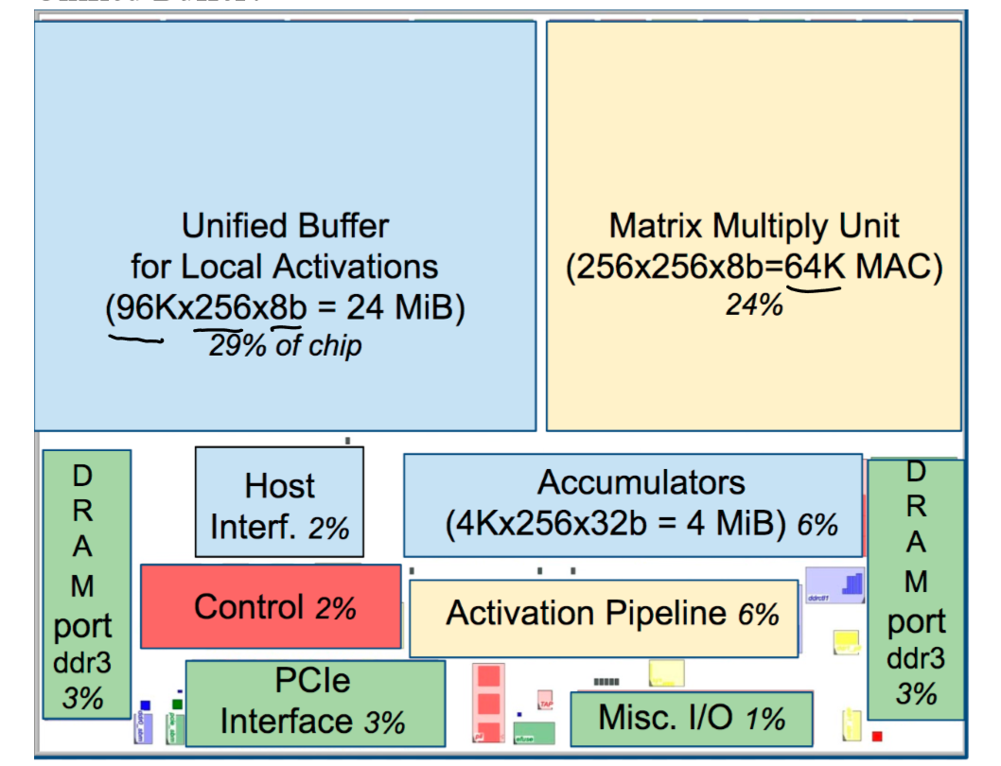
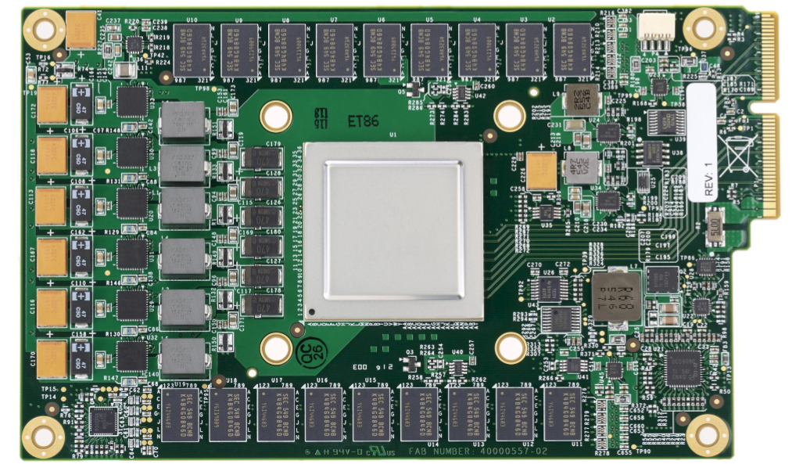
TPU

Slide 6
Software
User Space Driver
It sets up and controls TPU execution, reformats data into TPU order, translates API calls into TPU instructions , and turns them into an application binary .
Kernel Driver
Handles only memory management and interrupts. It is designed for long-term stability.

Slide 7
Performance
Roofline Performance model
Response time
Throughput (IPS)
Cost-performance
Energy proportionality

Slide 8
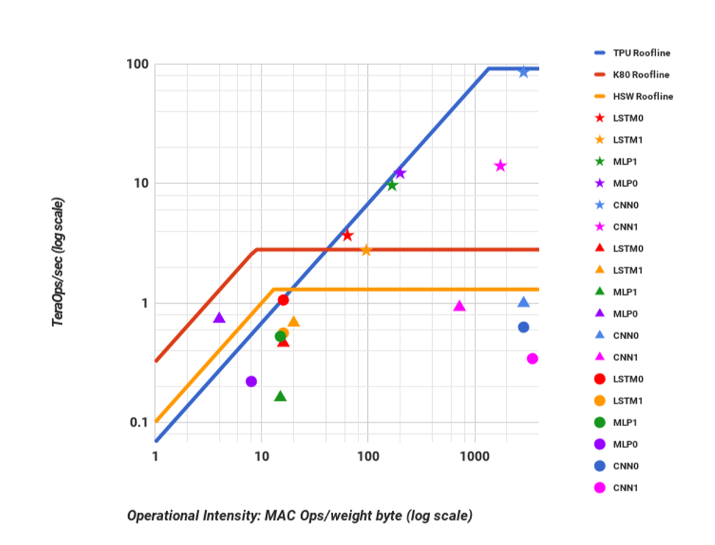
Performance
Roofline Performance model

Slide 9
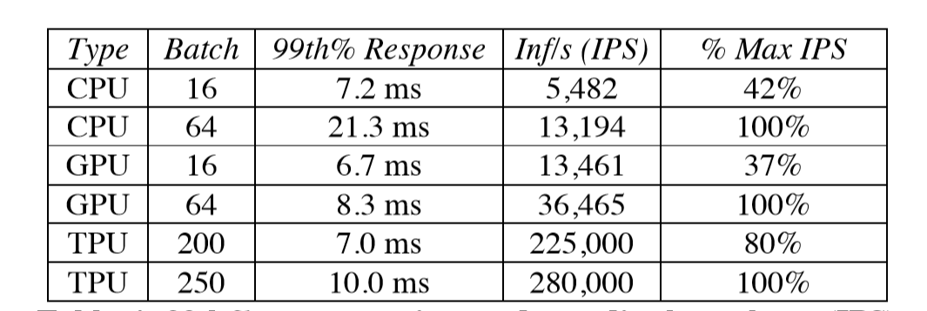
Performance
Response time
Throughput (IPS)

Slide 10
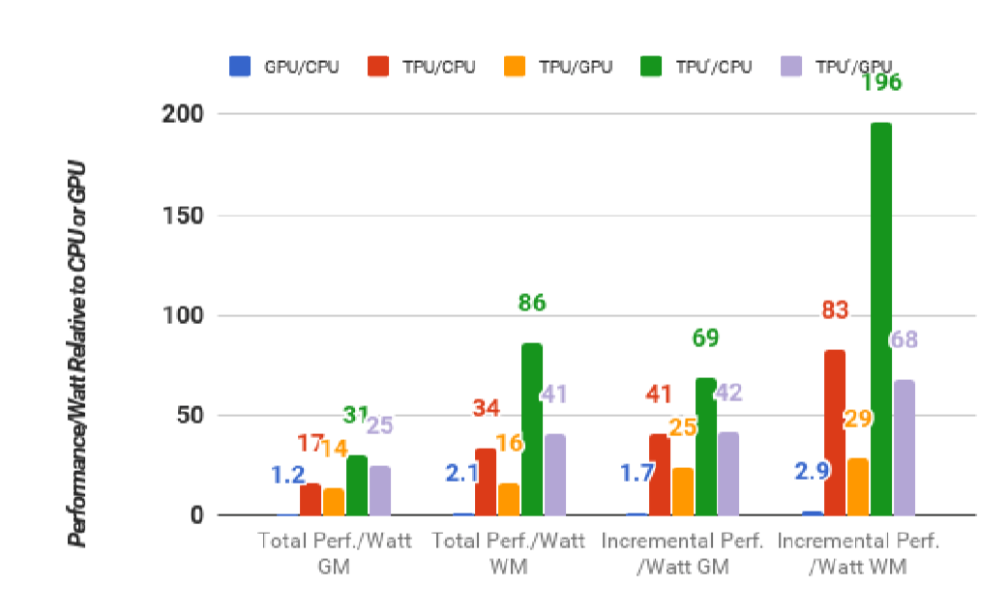
Performance
Cost-performance

Slide 11
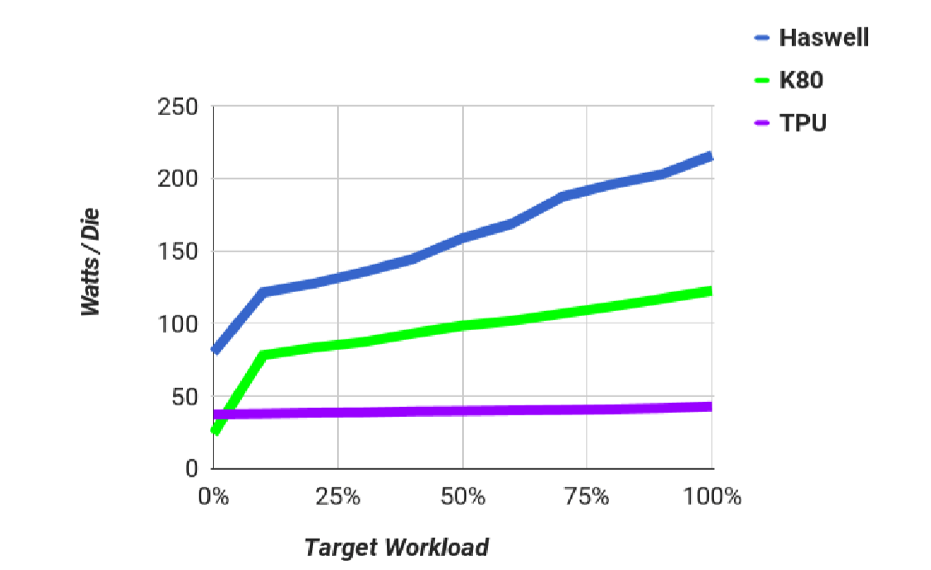
Performance
Energy proportionality

Slide 12
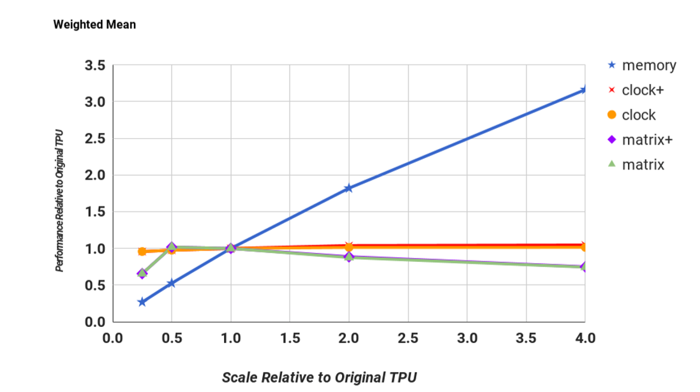
Evaluate

Slide 13
Evaluate
TPU is on average about 15X – 30X faster than its contemporary GPU or CPU,
TOPS/Watt about 30X – 80X higher.
using the GPU’s GDDR5 memory in the TPU would triple achieved TOPS and raise TOPS/Watt to nearly 70X the GPU and 200X the CPU.

Slide 14
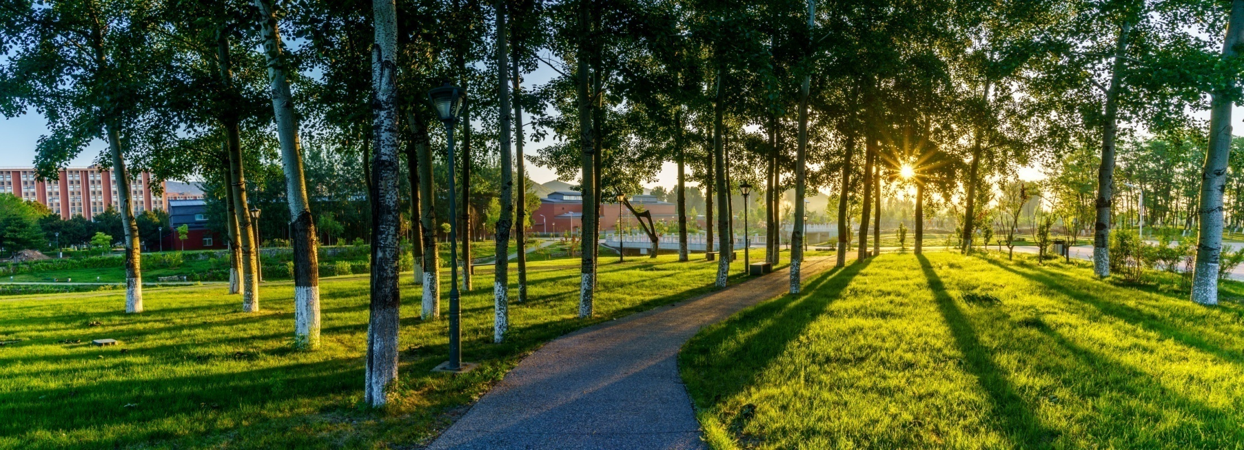

THANKS

